Slide 1
Gold Price Forecasting
Dhruvi Patel
Yuvraj Pawar
Notes:
ID=d924773e-9a16-4d6d-9803-8cb819e99682 Recipe=text_billboard Type=TextOnly Variant=0 FamilyID=AccentBoxWalbaum_Zero

Slide 2

Objective of our project.
Objectives
The objective is to understand the underlying structure in your dataset and come up with a suitable forecasting model which can effectively forecast the gold price for next 30 days.

Slide 3





Project Architecture
Data Understanding
EDA Visualization
Model Building
Model Deployment
Model Evaluation

Slide 4
Data extraction
We have used historical data for Gold rates since last 3 years from website called ‘Yahoo Finance’.
Every single day , the data is updated on the website so that we can check the model performance accordingly.

Slide 5
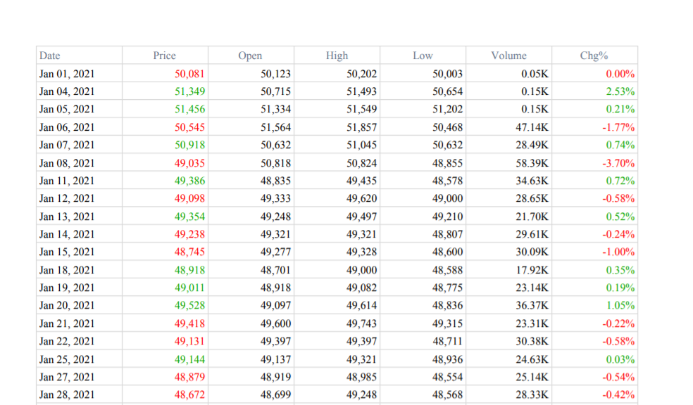
Dataset
Date wise Gold rates from Jan 01,2019 to todays date.
Each day new row is going to add in the existing dataset.
We will fetch the daily updated data using inbuilt python library called ‘yfinance’.

Slide 6
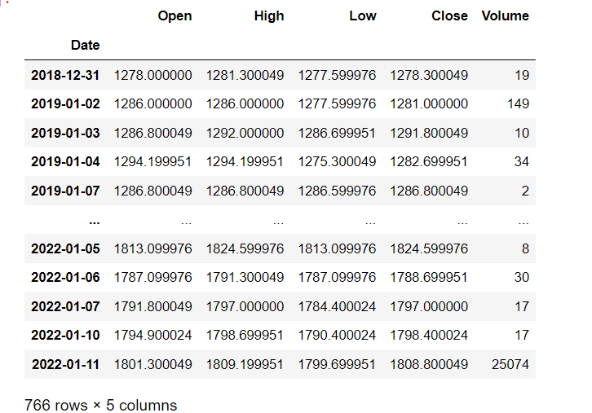
EDA
Original Dataset
(1)There are total 766 instances of 5 attributes.
(2)Date is the index here in the dataframe.
(3)Only the ‘closing price’ of the gold is our part of interest.

Slide 7
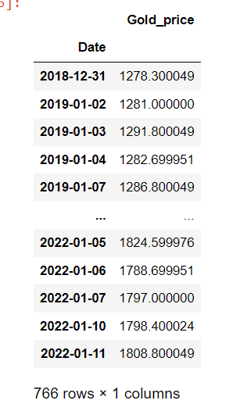
EDA
Final Dataset
(1)Since the daily ‘Closing price’ of gold was our part of interest , the final dataset has only one column called “Gold_price”.
(2)This Dataset shows the daily price chart for gold per oz in USD since last 3 years.

Slide 8
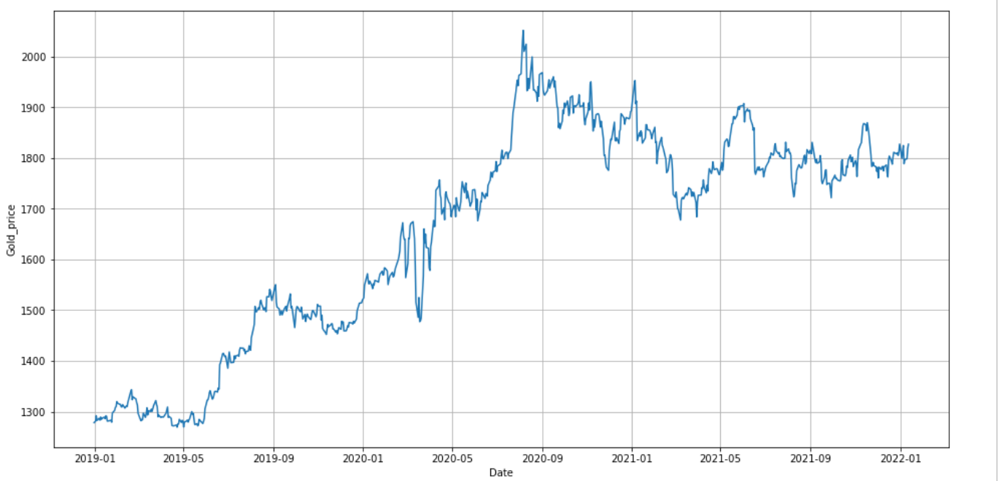
EDA
General gold trend

Slide 9
ARIMA model
(1)As we can clearly see from the plot that there is a trend in the variable path.
(2)This shows the the data is not stationary so atleast a first order differencing is necessary.

Slide 10
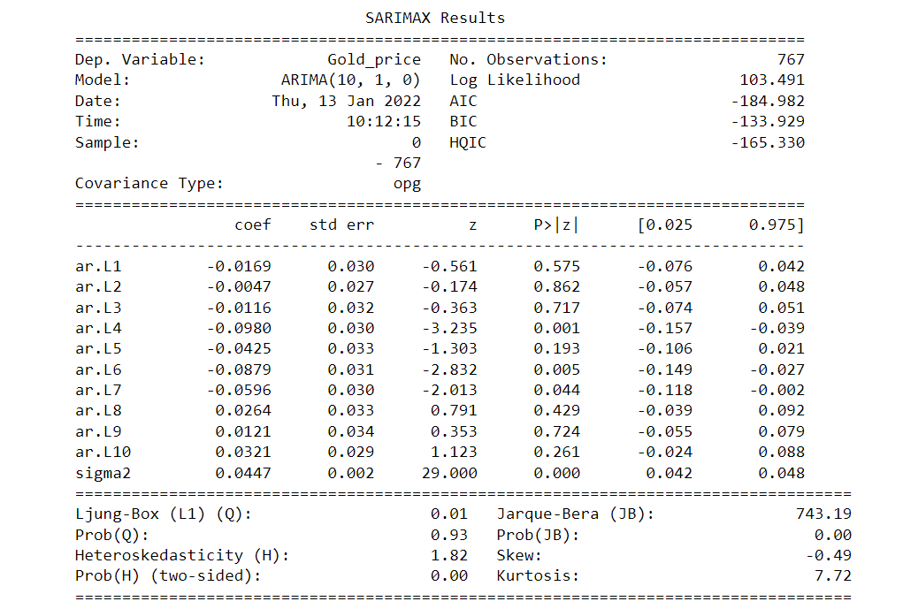
ARIMA
(1) We have separated the dataset into training and testing data with 80:20 ratio respectively, Hence no. of observations in the above summery is 766.

Slide 11
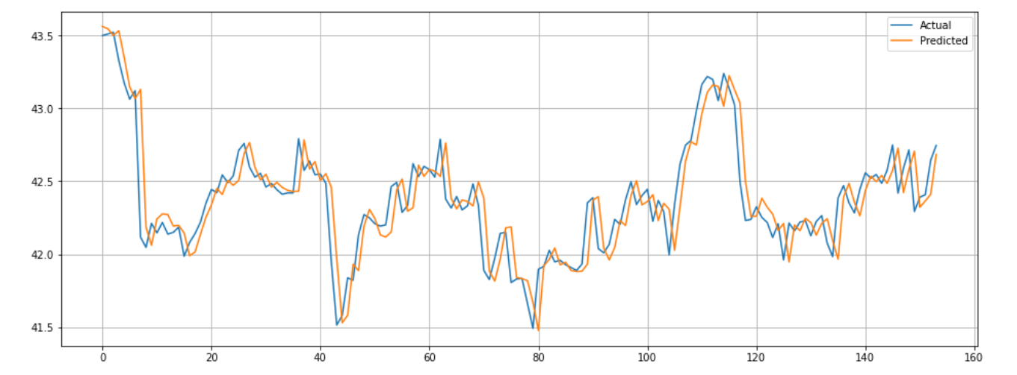
ARIMA
(1) After training, we tested our model with the 20% testing data and the above plot shows the result that we got.
(2) The blue graph shows the actual gold prices where as the orange one shows what our model has predicted.

Slide 12
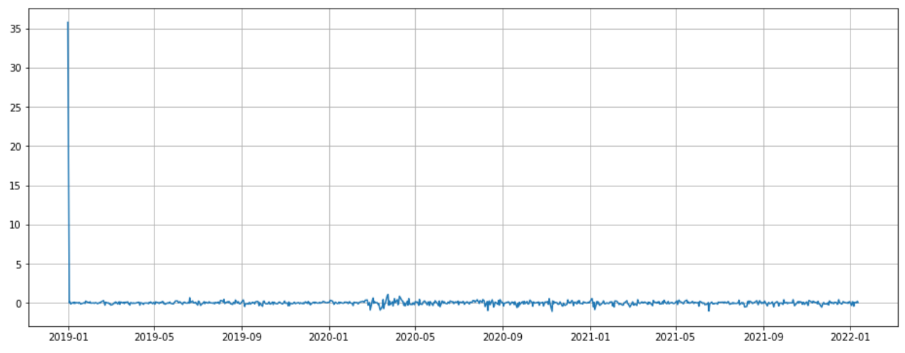
ARIMA
The residuals plot
(1)The above plot shows the residuals that we got throughout the testing timeline.
(2)We can see from the plot that mostly the residuals are close to zero which is a good sign for the model.

Slide 13
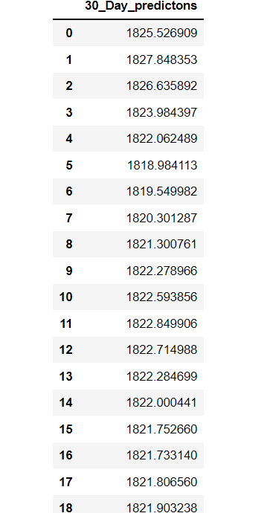
ARIMA results
(1) Finally we forecasted the gold price for next 30 days using model_fit.forecast() method.
(2) We created a data frame from the forecasted results and named the column as ‘30_day_predictions’.

Slide 14
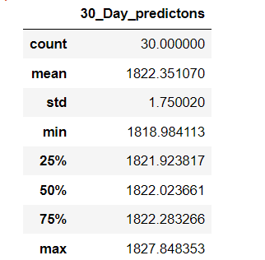
ARIMA results
Since we have converted the forecasted values into a dataframe, it becomes easier to analyze the probable trend in the upcoming month.
we can infer that the mean price for the entire upcoming month will be 1822$.
The minimum surge might be around 1818 and the maximum around 1827.
It also gives us the probable median price that is 1822.28.

Slide 15
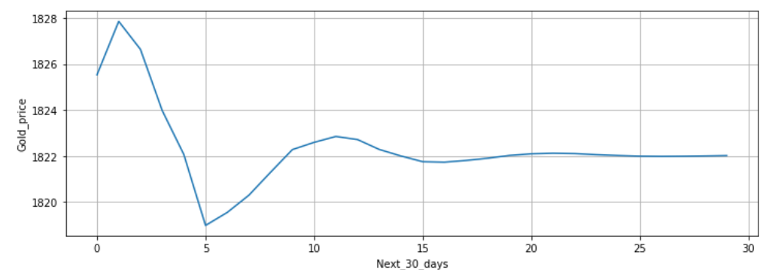
ARIMA results
Even after some stats analysis, A pictorial view will always give a better idea to the investors.
The above plot shows the gold price trend for the upcoming month which our model has predicted.
We can clearly see that there might be a sudden downfall in the first 5 days just after a peak hit .
After the 15th day , the gold price tend to show stability at around 1822$.

Slide 16
Model Deployment
(1) There are lot of model deployment options available , out of which we have chosen the ‘Streamlit ’.
(2) Python as inbuilt library called streamlit using which we can make web applications and deploy our ML model over there.
(3) We executed an application program in spyder using streamlit library so that it becomes user friendly forecasting app.

Slide 17
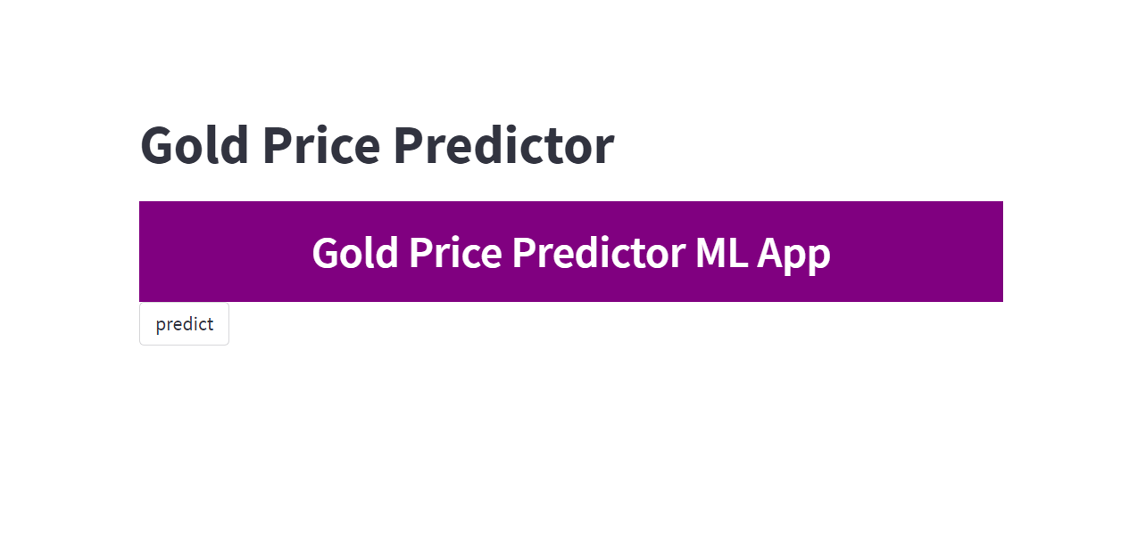
Model Deployment
(1) This is the simple front end of our ML app.Ofcourse we can make it more featuristic and user friendly.
(2) There is a button called ‘predict’ which on clicking , user will get the prediction results.

Slide 18
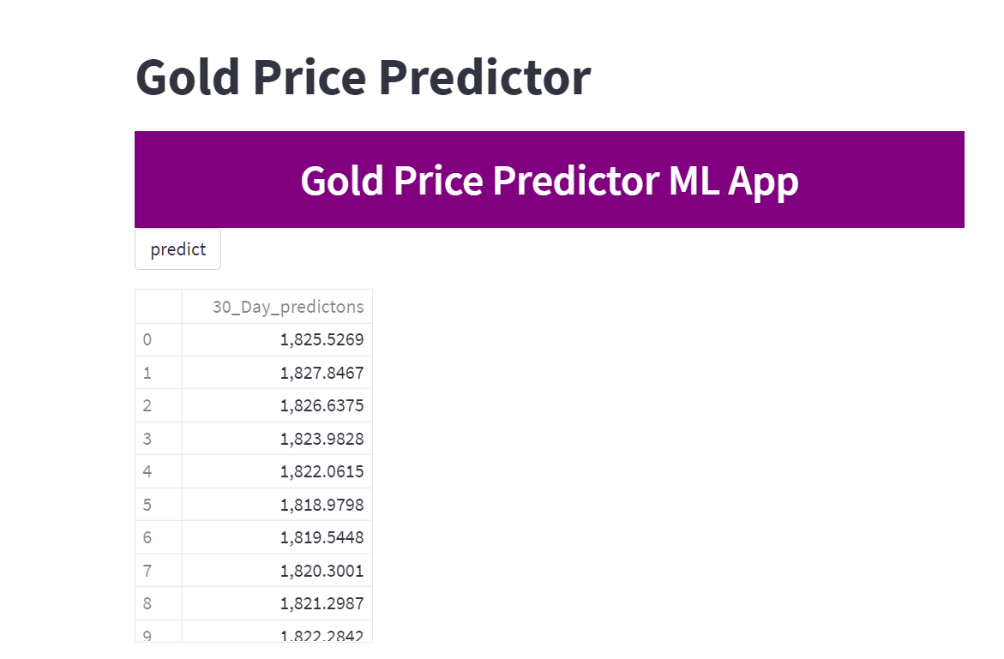
Model Deployment
By clicking predict , The upcoming 30 days predicted values will be there in the dataframe.

Slide 19
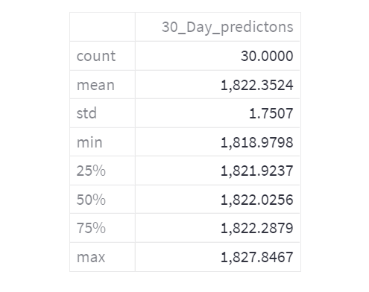
Model Deployment
Along with the 30 days predicted values ,the can also see the analysis of the upcoming month gold price trend and the graphical view as well which makes it more informative .

Slide 20

Thank you

